Slide 1
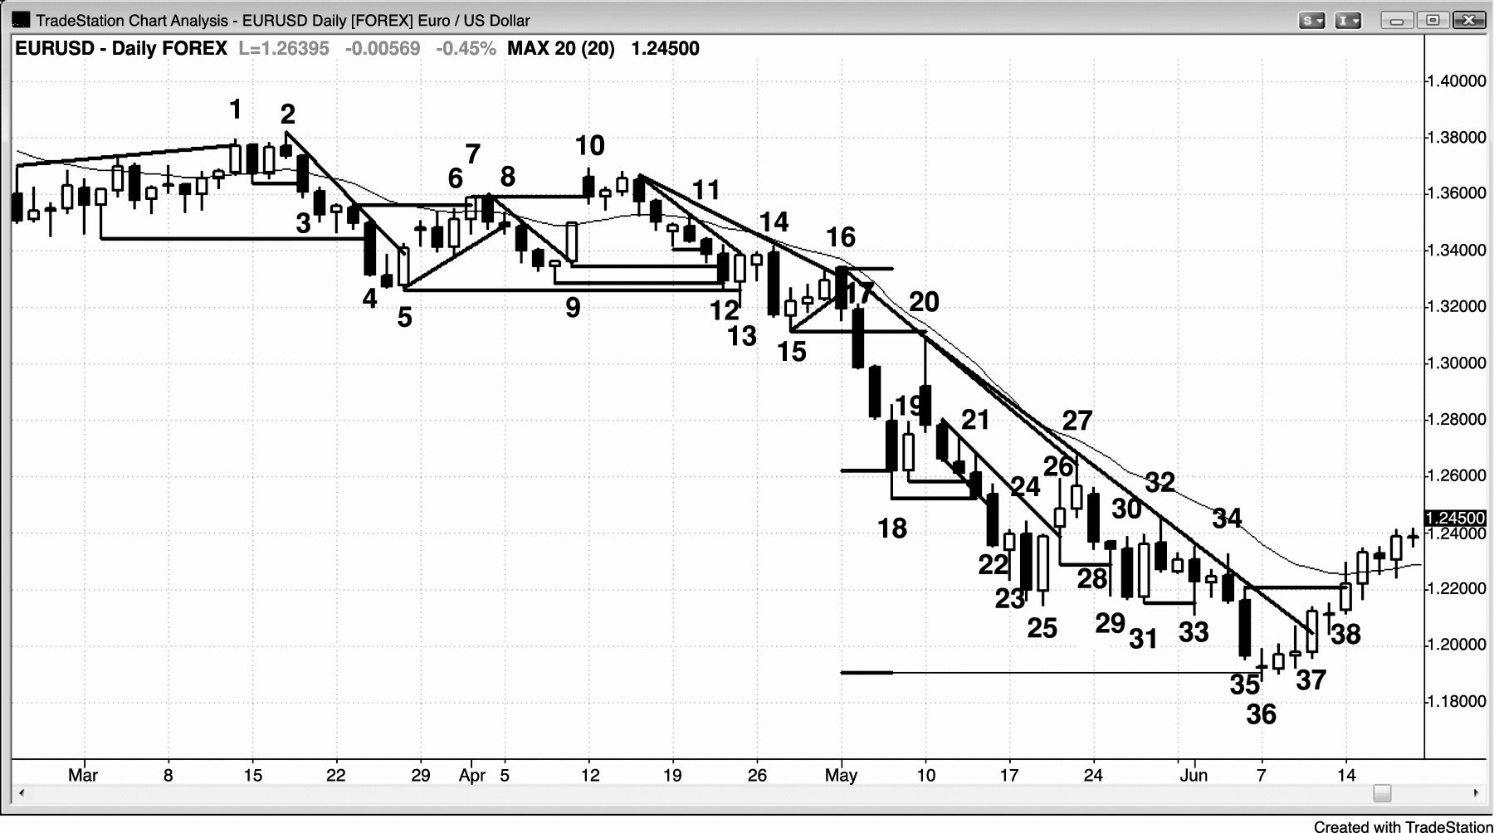
FIGURE 2.1 Breakouts Happen Many Times Every Day

Slide 2
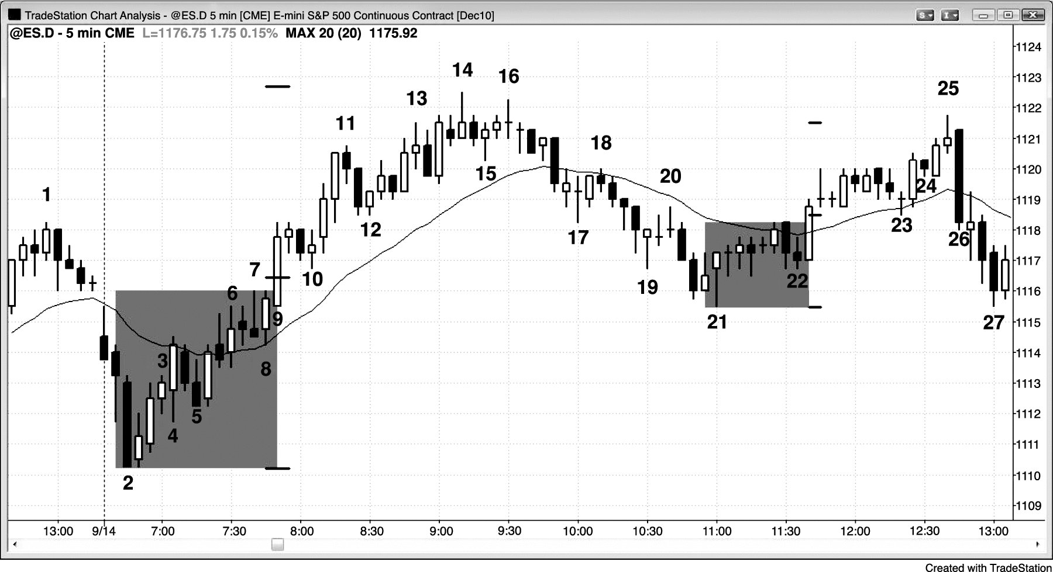
FIGURE 2.2 Flags Can Break Out in the Less Likely Direction

Slide 3
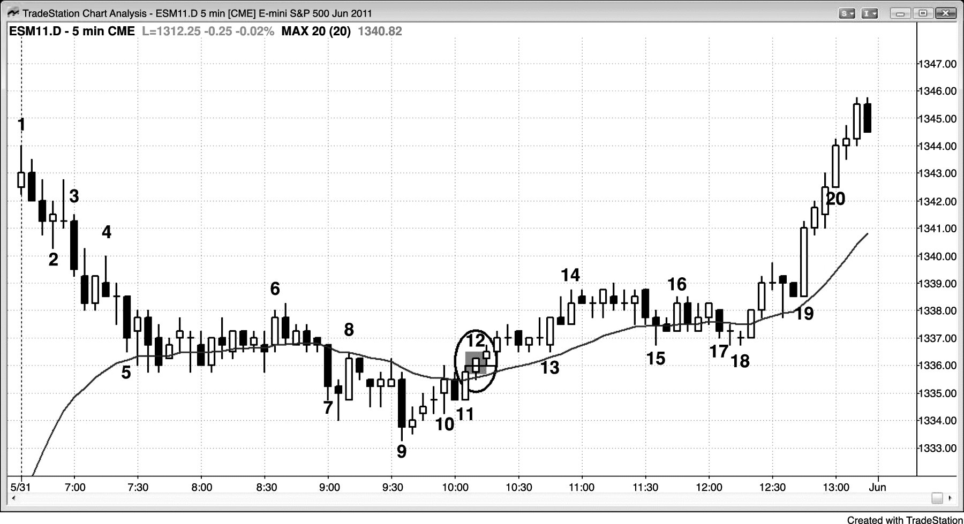
FIGURE 2.3 Small Breakout Bar

